Slide 1

CCPS 506
Comparative Programming Languages
Fall 2019
Lecture 11: Traits in Rust, course conclusion

Slide 2


Course Administration
Exam next week (Dec 7):
35% of final grade
3 hour duration
9:10 to 12:00 am
90% Rust and Haskell, 10% everything else.

Slide 3
Course Administration
No lab this week.
Get those assignments in!

Slide 4


Slide 5

struct

Slide 6
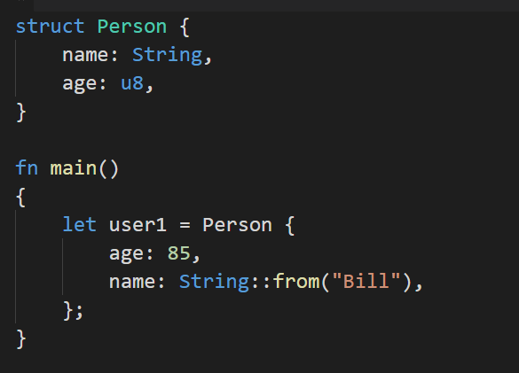
Structures: Similar to C/C++
Can contain heterogeneous data, just like tuples:
Struct fields separated by commas. Even the last item ends in a comma.
Must indicate type
Declare struct as follows:
Indicate values for each field
Again, separate by commas.
Need not declare in same order!

Slide 7
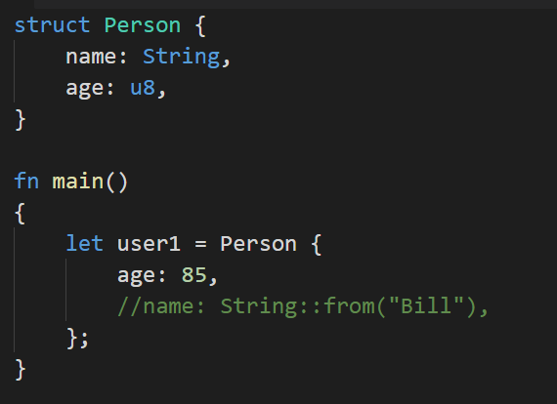
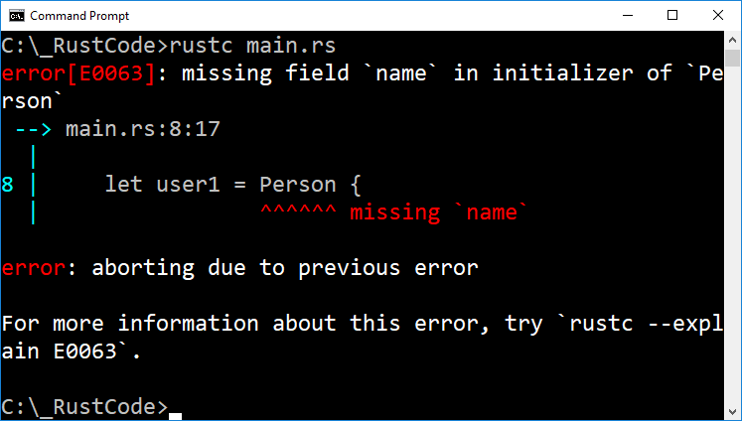
Structures
When declaring, must assign values to all fields:

Slide 8
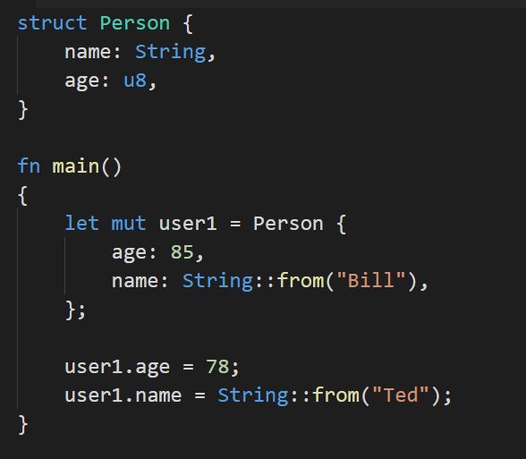
Structures: Accessing Fields
If we want to change struct values, must declare using mut
Entire struct must be mutable
Use the dot operator to access
Notice we’re using String::from to assign a value to name

Slide 9
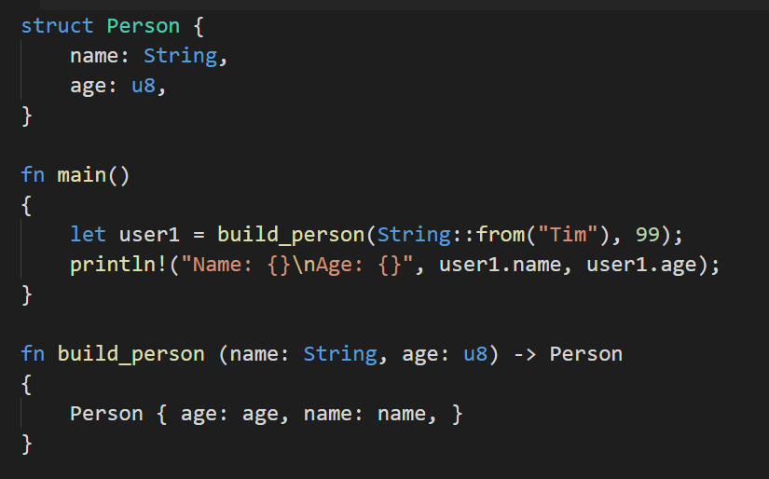
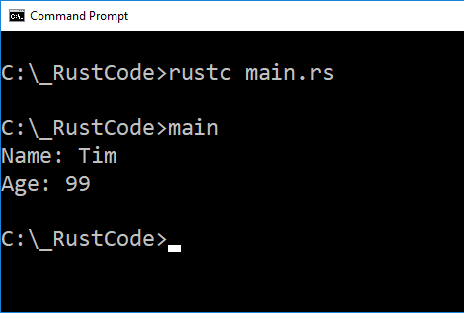
Structures: As Function Arguments
Return type is our struct name
Function ends in an expression, returns a Person struct.

Slide 10
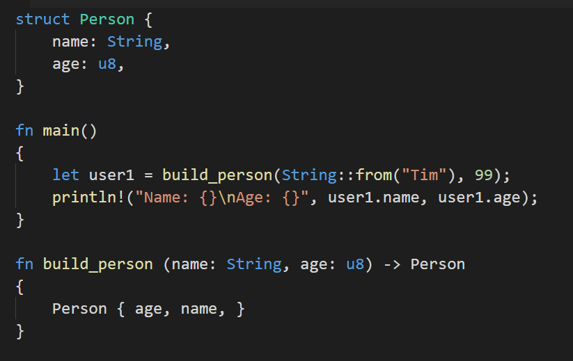
Structures: Argument Shorthand
If the name of the parameter is the same as the struct field, we can create the struct as seen here:

Slide 11
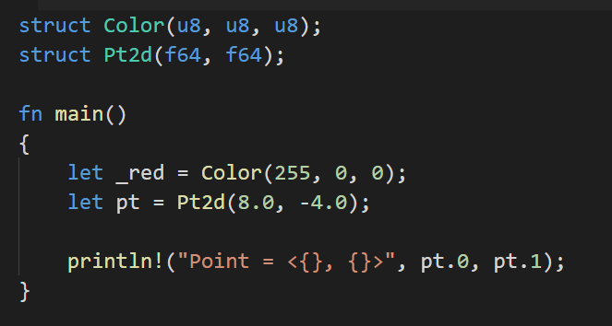
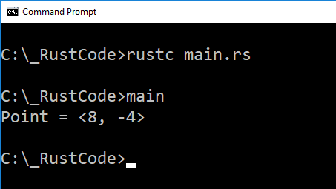
Tuple Structures
Notice:
Fields are not named.
We access them using numeric index, just like a normal tuple.

Slide 12
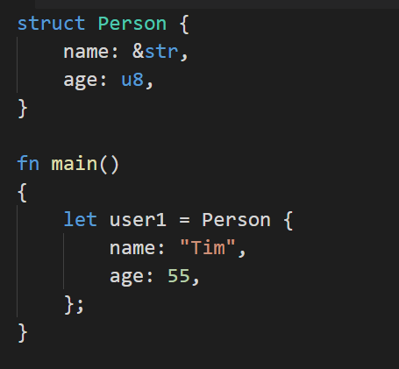
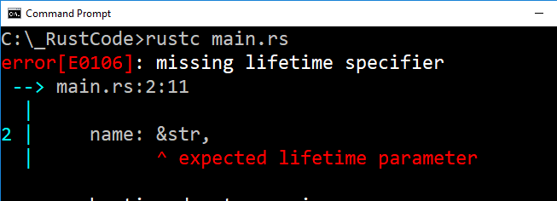
Structures, References, Lifetimes
Notice:
name is declared as a string slice (&str)
We should be able to initialize it with a literal.

Slide 13
Structures, References, Lifetimes
Danger:
This reference could point to data owned by something else
Similar to the dangling pointer problem
Struct might still be in scope, while the data referenced has gone out of scope.
We can annotate lifetimes here

Slide 14
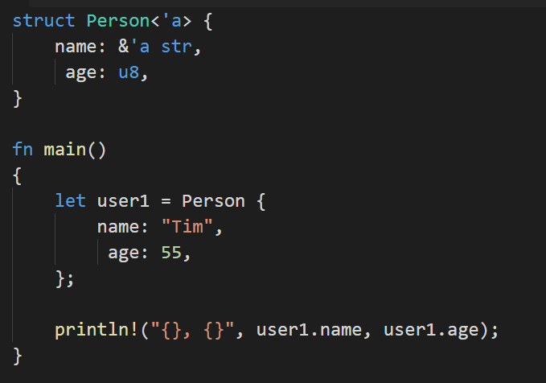
Structures, References, Lifetimes
All we’re saying here is that an instance of Person won’t outlive the reference it holds in its name field.
In other words, user1 cannot outlive “Tim”

Slide 15
Methods VS Functions
Like functions, methods can accept parameters, return a value, and contain code that is run when called.
Unlike functions, methods are defined within the context of a struct (or trait, or enum, as we’ll also see).

Slide 16
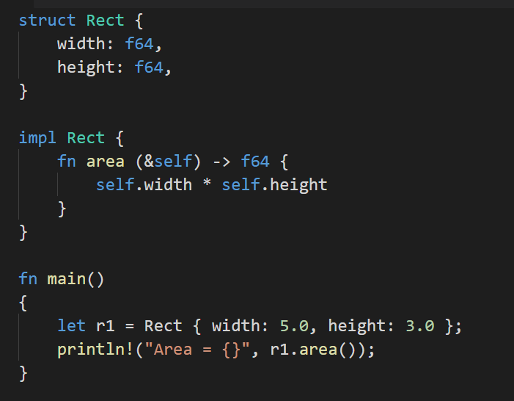
Rect struct containing two fields, width and height
Method area implemented for Rect structs. Use impl block.
&self refers to the calling struct
self.width and self.height reference struct fields.
Similar to this in Java.
Call area method for r1.
No args since we’re just going to reference self

Slide 17
Why Methods?
Keep behavior specific to a certain struct organized
Simplify arguments through self keyword.
Function VS Method:
Strictly speaking, we can have associated functions as well
The difference syntactically is that a function doesn’t use the &self parameter, while a method does.

Slide 18
There’s more to methods, but we’ll leave it here for now until we talk about traits.

Slide 19
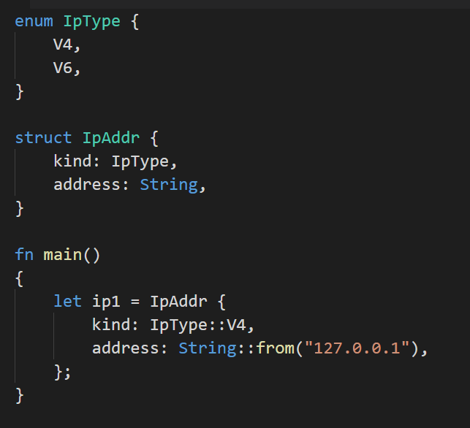
Enums
enum is used to define a custom type and the range of values it can take.
In this case, IpType can take the values of V4 and V6.
In our IpAddr struct, we have a field whose type is IpType.
Use :: to access enum values

Slide 20
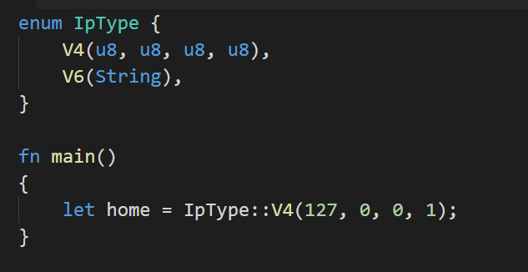
More Concisely
Instead of using a struct…
We can attach data directly to each enum variant.
Enum values are tuple structs

Slide 21

Pattern Matching
(with Enums!)

Slide 22
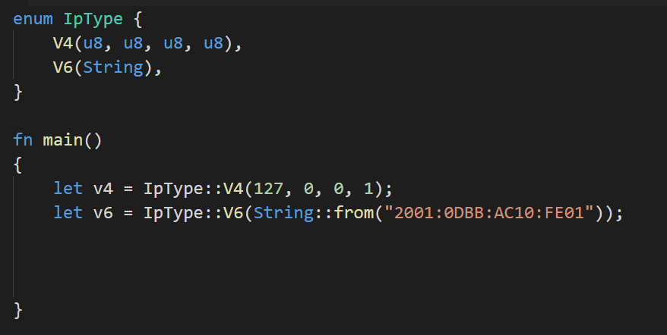
Pattern Matching with match
IpType enum from before
Declare two IpTypes, one V4 variant and one V6 variant.

Slide 23
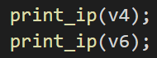
Pattern Matching with match
Call a function for printing IP addresses.
Problem: How we print depends on version

Slide 24
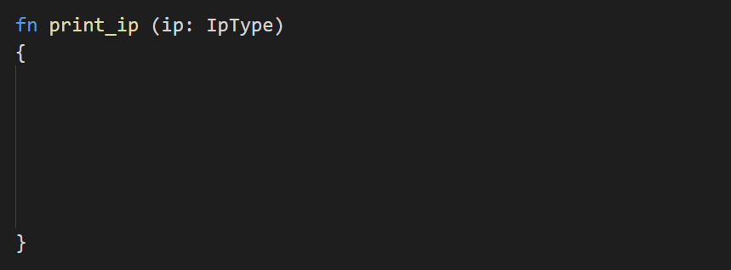
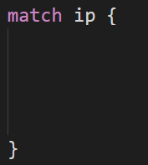
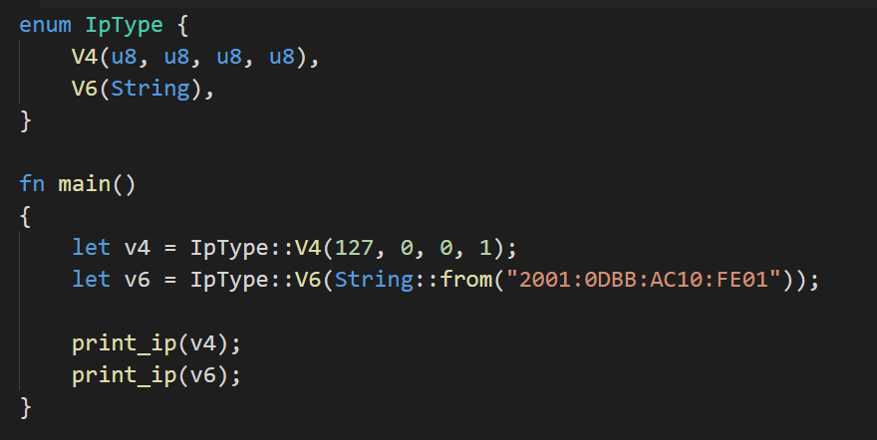
Pattern Matching with match
IpType arg, no return value
Pattern match input arg

Slide 25
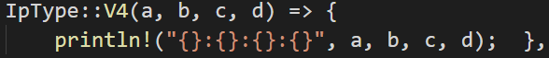
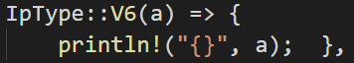
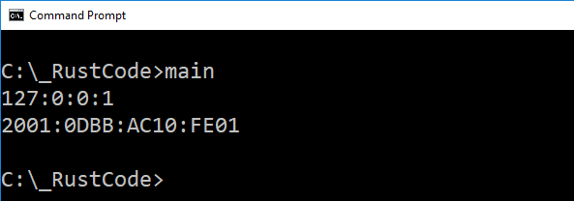
Pattern Matching with match
Each match branch can be an entire block
V4 case. Notice four values for members of V4
V6 case.
Single value for String

Slide 26
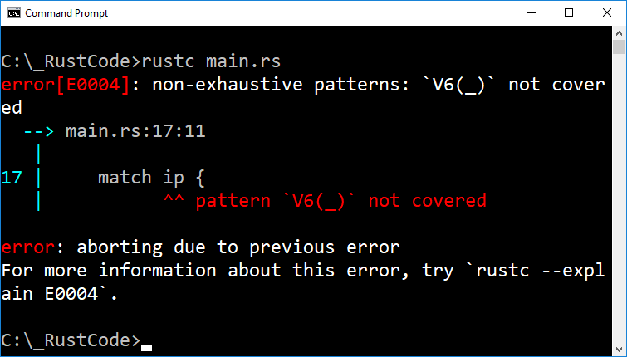
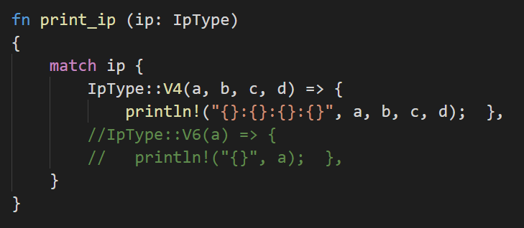
Rules: match
Like Haskell, match structures must be exhaustive:

Slide 27
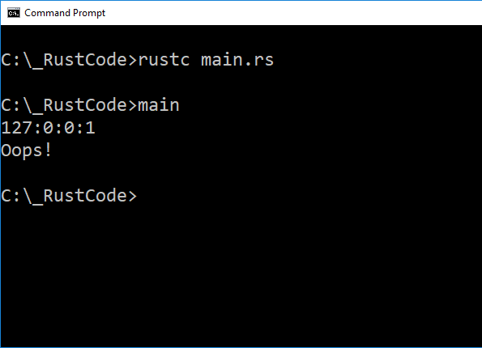
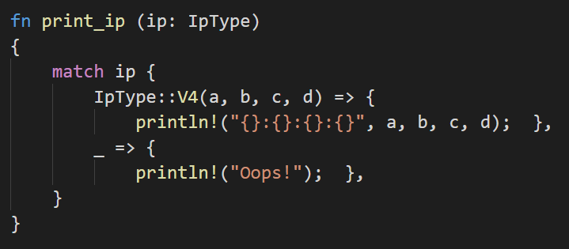
Rules: match
Also like Haskell, underscores are wild:

Slide 28
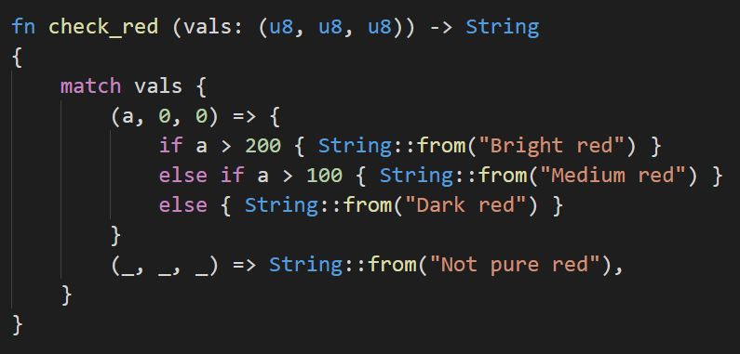
Nested Clauses
If/else inside a match case
Result of if/else is an expression
Will result in a String

Slide 29
Enum: Option
Rust defines an Option enum. Used to test if a value is something or nothing
Just like Maybe in Haskell!
What’s wrong with NULL?
It’s easy to accidentally use NULL as a non-NULL value
Dereference NULL pointers, use NULL value in computation
May or may not cause run-time errors
The concept of NULL is pervasive. Easy error to make.

Slide 30
Option
NULL is a very useful concept.
The problem is its implementation
Default integer value instead of unique type.
Haskell implements Maybe, Rust implements Option
data Maybe a
= Just a
| Nothing
enum Option<T> {
Some(T),
None,
}
T is the Rust equivalent, a generic type parameter
a is a type variable

Slide 31
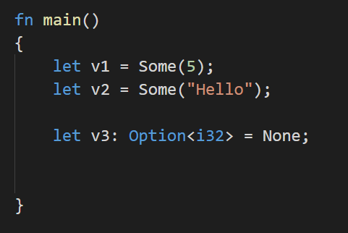
Option
It’s built into Rust, we can just use it
Notice:
When using None, we specify a type.
Rust can’t infer a type from None.

Slide 32
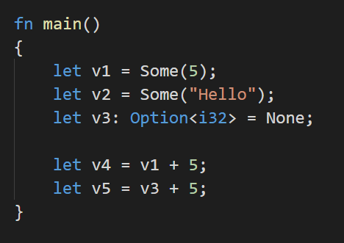
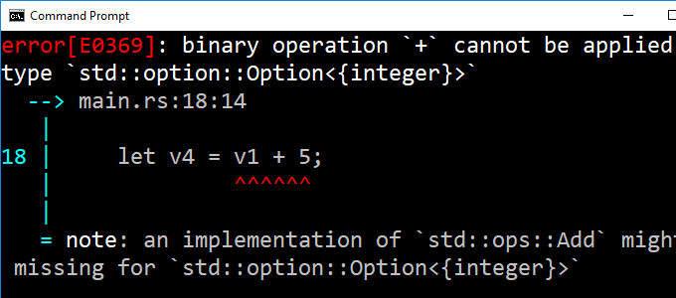
This highlights the difference between using NULL vs Option or Maybe:
We can’t implicitly convert Option for arithmetic or other operations.
Thus, we get a compile error
With NULL, code compiles perfectly fine because it’s just a value.
Causes runtime errors that are more dangerous, and trickier to track down.
The burden is still on the programmer to identify when Option should be used.

Slide 33
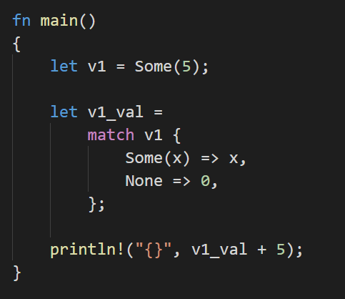
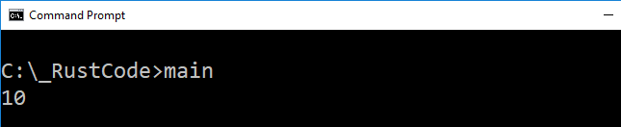
Pattern Matching with match
T from Some(T)
Very similar to Haskell
Extract value x from Some(x)
Decide on some default value for None
In this case, we say 0. Sensible because we’re just using v1_val in an addition.
Notice we’re treating the match structure as an expression
Just like we saw with if/else-if/else

Slide 34

Generic Types

Slide 35
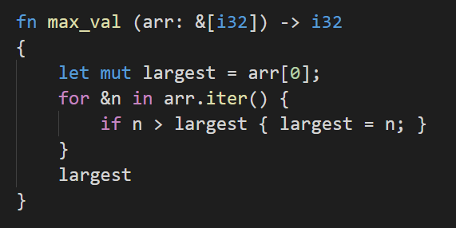
Generic Types
Consider a function that finds the largest item in an array:
Rust is strongly, statically typed.
This function will only work for arrays of type i32.
What about: i8, i16, i64, isize, u8, u16, u32, u64, usize, f32, f64, or even char?
Do we really need a different function for each type?
With what we know of Rust, you’d be forgiven for thinking that we did.

Slide 36
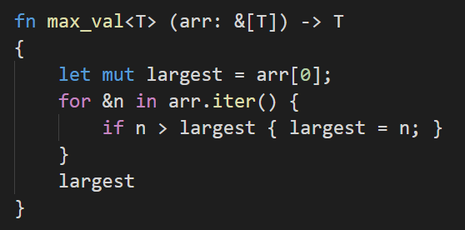
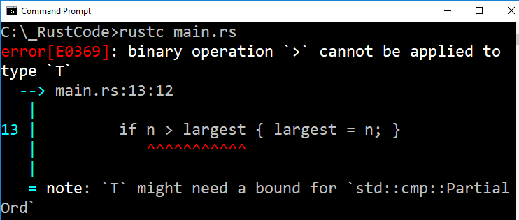
Generic Types
It can be done!
T is a generic data type.
We’re not done yet though:

Slide 37
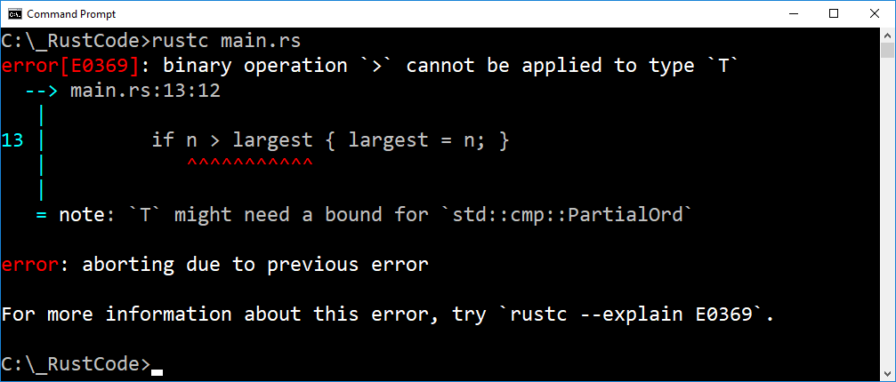
Function won’t work on all possible types T could take.
We’re doing comparison, T must be a type that can be ordered.
std::cmp::PartialOrd is a trait.
Recall: Traits in Rust are directly inspired by type classes in Haskell

Slide 38
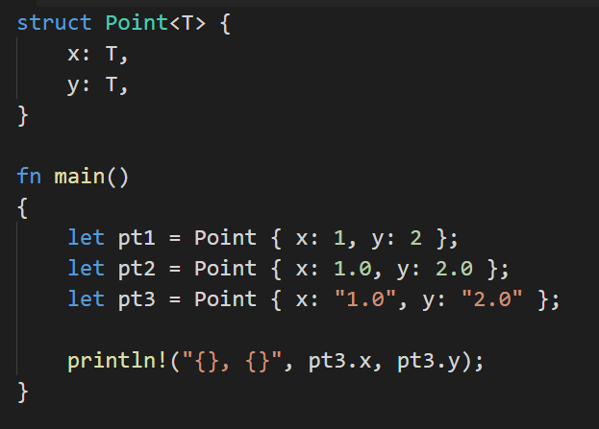
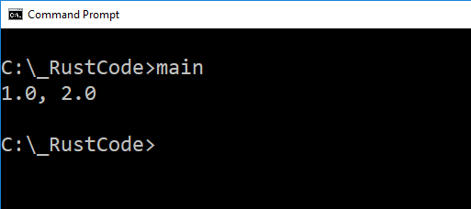
Generic Types: Structs
Here, it doesn’t matter what type T is
We’re not operating on it in any way
Points declared using int, float, and even Strings

Slide 39
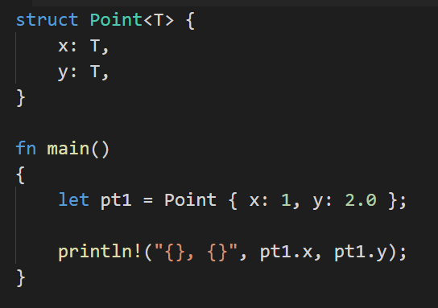
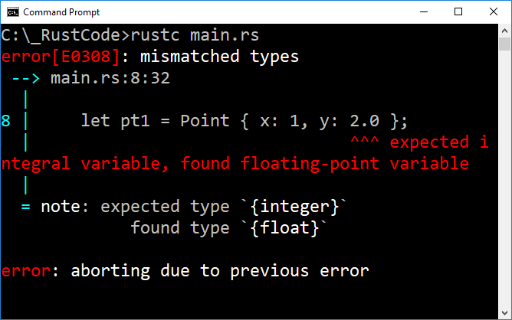
However…
Type of x and y must match

Slide 40
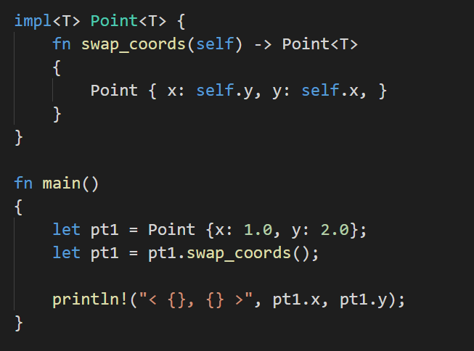
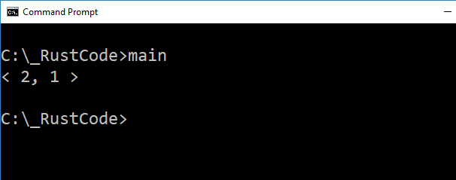
Generic Types: Struct Methods
Here, we’re moving ownership (no &)
That’s OK, we’re sending a new Point back to main.
It doesn’t matter what type T is, we’re allowed to create a new Point

Slide 41
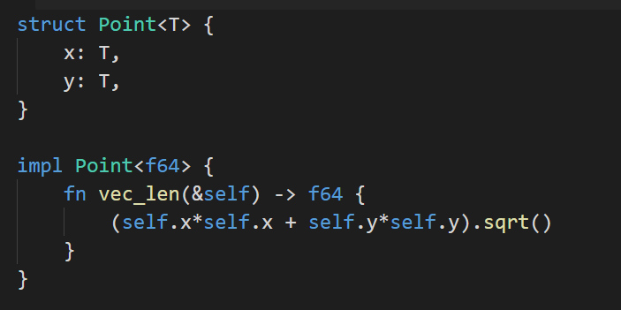
Generic Types: Struct Methods
Here, we implement a vec_len method for Point.
However, it is only implemented when T is f64.
If we left it generic, we’d get a compile error.
sqrt() and * aren’t defined for all possible T
Speaking of sqrt(), that’s weird…
We’re calling it as a method, rather than a function.
sqrt() is defined for types with a specific trait.
Traits coming up.

Slide 42
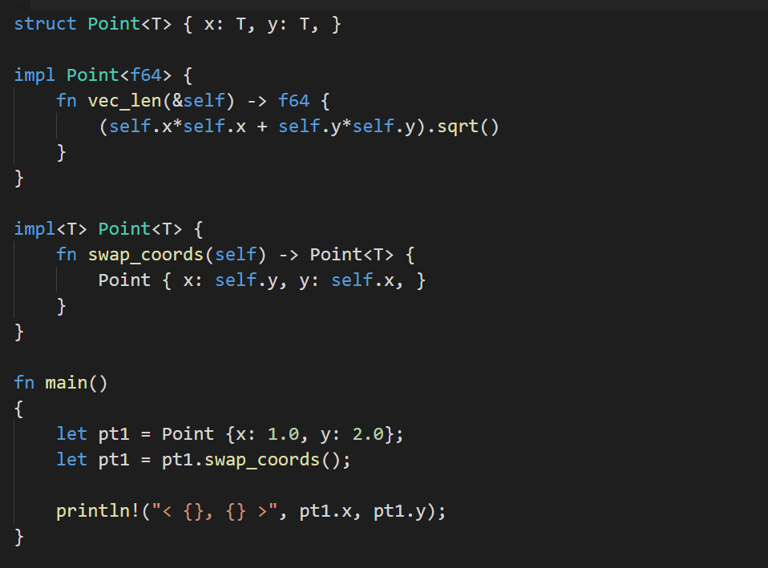
Struct with two values of generic type T
Method vec_len implemented for Point, but only when T is f64
Method swap_coords implemented for any type T. Old point is destroyed, new point with swapped coords is returned
Add as many methods as we want
They can be implemented for specific types, or generic types.
Whatever the case, operations on the type must be defined.

Slide 43
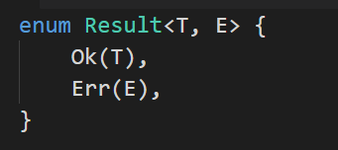
Generic Types: Enums
Here’s an example with two generic types.
Ok can have a different type from Err
Simply add more type variables in the definition
Problem: These types can’t stay generic forever.
Rust is statically typed – has to know concrete type at compile time if we’re using an instance of Result.

Slide 44
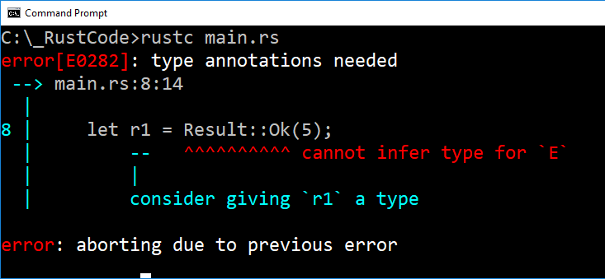
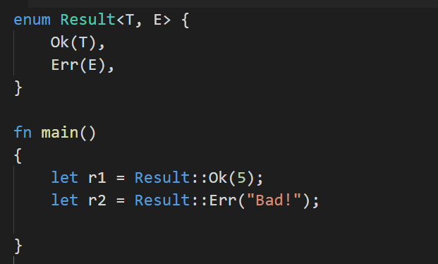
Generic Types: Enums
By providing 5 with Ok, that tells rust the type of T.
It says nothing about E.
Problem? Can Rust infer types?

Slide 45
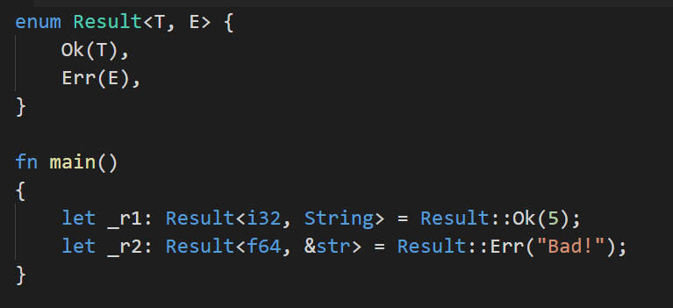
Generic Types: Enums
Now, for each Result variable, we’ve specified the type of T and E.
But… Why should it matter what type E is, if _r1 is Ok(T)?

Slide 46
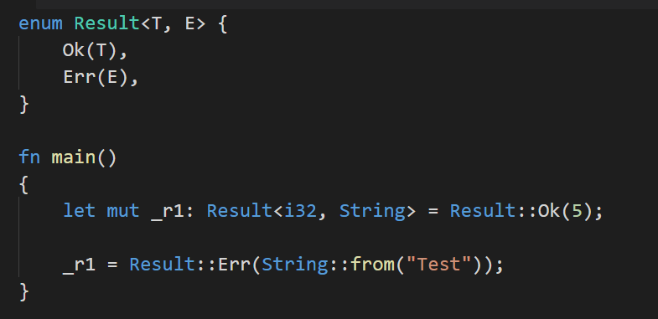
mut
If _r1 is mutable, it can take the value of Ok(T) or Err(E)
Thus, Rust must know the type of each at compile time.

Slide 47
Traits

Slide 48
Traits
A trait tells the Rust compiler about functionality a particular type has
Inspired by type classes in Haskell, similar to interfaces in Java
Let’s revisit our max_val function:

Slide 49

In max_val, we compare two values of type T.
This behavior isn’t defined for all possible values of T.
Comparison is defined for types with the PartialOrd trait.
Just like Haskell’s Ord type class

Slide 50


Tell Rust we want max_val to accept any type T that implements the PartialOrd trait.
We’re almost there…

Slide 51
Roughly speaking:
Not all types implementing PartialOrd are stored on the stack
There is still potential here for T being a type stored on the heap (i.e. String)
This error comes from us trying to (potentially) copy a heap variable.
Recall, of Strings:

Slide 52

Ownership moved from s to word!
s is now invalid!
This is very different from any other language we’re used to.
This doesn’t happen with primitives because they will simply be copied.
The String is not copied! Its ownership is moved!

Slide 53

We can fix this! We have the technology!
Now, max_val will work on any type T that implements Copy and PartialOrd traits.

Slide 54



Slide 55


?
Interesting, I thought Copy wasn’t implemented for String?
Except, these are not Strings. They’re literals, which means they’re &str
Copy and PartialOrd are implemented for &str

Slide 56



Slide 57

Traits and Methods
Clunky. Let’s create a method we can call that will print our Points.

Slide 58


Makes sense right? Except…
We’re assuming that Rust knows how to print every type T.
Turns out this isn’t the case.
Not to worry! Display is a trait. We know how to use traits.

Slide 59


First time seeing:
Similar to a “using namespace” statement in C++
Include the Display trait in the impl definition.
Now, the print method will work for any type T that implements Display

Slide 60
Implement Traits For Custom Types?
Everything we’ve seen regarding traits so far has been about restricting functions or methods to types with specific traits.
What if we want to implement a trait for a certain type?

Slide 61


Custom Trait: Pt3D
Create a new trait (using trait keyword) called PointOps.
This trait will contain operations on our Pt3D data type
Initially, we’ll start with a simple method for addition.
This method is invoked from some type, accepts that type as an argument, and returns that type
T = T.plus(T)
This is just a method header!
What about the implementation?
&self is a reference to the calling variable
Self is the type of self
Keeps this trait generic!
Any type can implement it

Slide 62

Custom Trait: Pt3D
We’re implementing the PointOps trait for our Pt3D type
Inside the impl we find our method definition(s)
We create and return a new Pt3D whose elements are the sum of the Pt3D that invoked the method, and the Pt3D passed in as an argument.
Notice this implementation is specific to Pt3D
Sensible, since we’d need different behavior for different types

Slide 63


Custom Trait: Pt3D
If we implement a trait for a particular data type, we are required to implement all methods
Compile error otherwise:

Slide 64

Custom Trait: Pt3D
Let’s test our plus method
Declare two points, call the plus method on p1, pass in p2 as argument.
Store the result in a new point, p3.
Print p3.
Unacceptable. Let’s create and implement a print method in our PointOps trait

Slide 65



Custom Trait: Pt3D

Slide 66
By the way:
If we want formatted output a la printf, we can use format! Instead of println!
Feel free to Google it, usage is fairly straightforward.

Slide 67
We’ve implemented our custom PointOps trait for Pt3D
Can we implement it for another type? How about Pt2D?

Slide 68

Custom Trait: Pt2D
Our trait can stay the same.
It’s already generic enough for Pt2D.
Self can be anything!

Slide 69

Custom Trait: Pt2D
This time, impl PointOps for Pt2D
Functionality is implemented similarly
Only difference is that we’re dealing with a 2D point instead of 3D.

Slide 70



Custom Trait: Pt2D

Slide 71
Implement Existing Trait For Custom Types?
We can restrict functions or methods to types with specific traits.
We can create custom traits.
What if we want to implement an existing trait for a certain type? For example, the Copy or Display trait for Pt

Slide 72

Two Options: #derive
Recall:
p1 is moved to p2
We can no longer use p1!

Slide 73
p1 is moved to p2
We can no longer use p1!
Ownership - Three Rules:
Each value in Rust has a variable that’s called its owner.
There can only be one owner at a time.
When the owner goes out of scope, the value is dropped.

Slide 74

p1 is moved to p2
We can no longer use p1!
Move occurs because Pt2D doesn’t implement Copy.
Variables are moved by default, unless they implement Copy
Can we implement Copy?

Slide 75
Implementing Copy
Rule: A struct can implement Copy if its components implement copy.
The elements of Pt2D are just f64.
They certainly implement copy.
We should be OK

Slide 76


#derive
Huh? We can’t implement Copy without implementing Clone?
Clone is a supertrait of Copy

Slide 77


#derive
We’re now copying instead of moving
p1, p2 are different objects in memory
Can still make use of p1!

Slide 78


Rule: A struct can implement Copy if its components implement copy.
We already know that String doesn’t implement Copy.
What happens if we try?

Slide 79


#derive Display?
Nope. But we can implement it ourselves!

Slide 80

Implement Display?
Doing so requires us to know what methods the Display trait requires.
The method signature for displaying a type using { } in a println! Is as follows:
Format your output as desired here

Slide 81


Trickier than Haskell, but doable.

Slide 82
As we can see, traits are a powerful mechanism for achieving type polymorphism custom type behavior in Rust
Traits are directly inspired by Haskell’s type classes, and it shows.
Haskell type classes
Must (should) implement minimal set of operations
Can derive existing type classes
Can implement existing type class
Rust traits
Must implement methods described in trait definition
Can derive existing traits
Can implement existing traits (trickier)

Slide 83
Fantastic Rust Reference:
https://doc.rust-lang.org/book/second-edition/

Slide 84


Slide 85
Always Remember
The line between different paradigms is grey.
Paradigms classify languages based on their features
Any given language can possess features from multiple paradigms and thus belong to both.
C is considered a very imperative language, but it supports first class functions through the use of function pointers.

Slide 86
Some paradigms are concerned with how code is organized:
Pure imperative vs. procedural
Objects vs. primitives.
Others are concerned with how a program executes:
I.e. does it allow side effects?
Functional vs. Object Oriented
In the history of computing, there have been many different paradigms.

Slide 87

The lowest level paradigm is simply machine code:
Every processor has an instruction set.
These instructions are simply bit patterns (binary)
These bit patterns get loaded into the CPU and physically executed by the CPU’s hardware.
One statement in Java might compile into half a dozen machine instructions or more.
Each machine instruction can be decoded:
Add registers 1 and 2, store the result in register 6:
0 1 2 6 0 32 decimal
000000 00001 00010 00110 00000 100000 binary

Slide 88



Have fun!

Slide 89
Assembly Language
Instead of a string of bits, assembly instructions make use of mnemonics and memory addresses can be given symbolic labels (variables):
MOV AL, 61h
This assembly instruction loads register AL with the Hex value 61 (decimal 97)
Much easier to read than its associated machine instruction:
10110000 01100001

Slide 90
Procedural Languages
Called third generation languages
Machine instructions being first-gen, assembly being second-gen
The first so-called “high level” languages:
COBOL
FORTRAN – Developed for scientific and engineering problems. Used mathematical language terminology.
ALGOL – Like FORTRAN targeted scientific and engineering problems. Focused on being an appropriate language for defining algorithms.
C – A general purpose language. No specific target problem domain.
These languages describe, step by step, the exact procedure to be followed.

Slide 91
Object Oriented Languages
C++, Smalltalk, Java, etc.
Data and methods are encapsulated together in a construct called an object.
With perfect encapsulation, object data is only accessible via accessor methods
set() and get() methods, accessor methods and mutator methods.
Objects have their own state, and that state can only be modified from within that object.

Slide 92

Perfect Encapsulation
Java and C++ don’t have or require it:
We can access the instance variable length of an array object directly.
With a String object, we’re required to invoke the accessor method length()

Slide 93
Perfect Encapsulation
Smalltalk, on the other hand…
Instance variables are private to the instance itself.
In Java, two instances of the same class can access each other’s private instance variables.
Recall, of Smalltalk, everything is an object, and:
A Smalltalk object can do exactly three things:
Hold state (assignment)
Receive a message (from itself or another object)
Send message (to itself or another object)

Slide 94
Perfect Encapsulation
Smalltalk, on the other hand…
A Smalltalk object can do exactly three things:
Hold state (assignment)
Receive a message (from itself or another object)
Send message (to itself or another object)
Receiving a message invokes a method associated with that message.
Accessing an instance variable would require a message send, and by definition receiving a message invokes a method.

Slide 95
Imperative?
Procedural and object oriented languages are still considered imperative.
Imperative Features:
Control structures are used to explicitly indicate the order of code execution.
Side effects are allowed. Some state can be modified at different points in time by different units of code.
I.e. The state of a global variable can be changed by two different functions or methods.

Slide 96
Declarative?
Roughly speaking, the declarative paradigm allows the programmer to think about the what rather than the how.
“Do this thing 5 times”
Compiler handles how it’s done, we don’t need to explicitly specify loop conditions or control variables
Express logic rather than control flow. Syntax appears very mathematical in nature. Recursion resembles mathematical induction.

Slide 97
Functional Programming
Languages with a declarative style
Functional programming emerged not long after the first high level languages
Lisp was the first functional “flavored” language, came out one year after FORTRAN (Late 1950s).
Pioneered the use of higher order functions and recursion
Many others followed – Scheme, Clojure, Elixir, Haskell

Slide 98
Functional Programming
Languages with a declarative style
The output of a function depends solely on the input arguments (no side effects)
void functions make no sense.
This makes it much easier to predict the behavior of a program
Primary motivation for developing functional programming
Flow control is not built into the language as separate constructs
Pass code blocks as arguments into function calls.
Smalltalk also does this!

Slide 99
Functional Programming
Flow control is not built into the language as separate constructs
This suggests there’s no iteration in the typical sense of the word.
Looping is accomplished with control structures in imperative languages.
If control structures are functions, that means looping is always recursive.
However - This refers to the high level implementation only.
Machine instructions can be optimized into iteration, as we saw with tail recursion and Elixir.

Slide 100
Functional Programming
?
Things that are generally foreign to imperative programming
First class functions and higher order functions:
Functions that return functions or accept them as arguments
First class functions can appear anywhere in the program that other first class entities (such as numbers) can.
Functions as arguments, return values, etc.
Higher order functions accept functions as arguments
Of course we’ve seen that some imperative languages also support first class functions (C and Rust).

Slide 101
Other Paradigms?
Imperative: Fortran, C, Rust
Object-Oriented: Smalltalk, C++, Java
Functional: Lisp, Scheme, Clojure, Elixir, Haskell
Concurrent:
Erlang, Elixir
A focus on concurrent computing/processing
Technically, and language that provides concurrency mechanisms could be here.
Rust, Java, C++, etc.

Slide 102
Recall, of Elixir
Elixir code runs inside lightweight threads of execution.
Isolated, exchange information via message passing.
Not uncommon to have hundreds of thousands of processes running concurrently in same VM.
Note: These are NOT operating system processes!
Extremely lightweight in terms of CPU and memory
A process need not be an expensive resource

Slide 103
Other Paradigms?
Imperative: Fortran, C, Rust
Object-Oriented: Smalltalk, C++, Java
Functional: Lisp, Scheme, Clojure, Elixir, Haskell
Concurrent: Erlang, Elixir
Parallel & Array: MATLAB
Focuses on processing vectors and matrices
Fantastic for rapid prototyping of applications that do a lot of linear algebra
Computer vision, etc.

Slide 104

Parallel & Array: MATLAB
Declare matrices and vectors
Linear algebra functionality built in
Performed automatically when operators supplied matrix arguments
Explicit looping is undesirable.
Better to implement loop as a single operation on a list instead.

Slide 105

Better to implement loop as a single operation on a vector instead.
MATLAB is optimized for vector operations.
Loop equivalent is much slower.

Slide 106
Other Paradigms?
Imperative: Fortran, C, Rust
Object-Oriented: Smalltalk, C++, Java
Functional: Lisp, Scheme, Clojure, Elixir, Haskell
Concurrent: Erlang, Elixir
Parallel & Array: MATLAB
Data Flow: LabVIEW
Program visually, drag and drop
Good for prototyping user interfaces and their underlying logic

Slide 107


Data Flow: LabVIEW
Forward-facing user interface
Underlying logic implementation

Slide 108
Control flow modelled as a directed graph
In this example, data “flows” from left to right.
The multiply must wait for the result of the division and subtraction.
Each of those must wait for their respective arguments.
When values change, recalculation of result is forced

Slide 109

Can even implement control structures like loops and selection (case).

Slide 110
Other Paradigms?
Imperative: Fortran, C, Rust
Object-Oriented: Smalltalk, C++, Java
Functional: Lisp, Scheme, Clojure, Elixir, Haskell
Concurrent: Erlang, Elixir
Parallel & Array: MATLAB
Data Flow: LabVIEW, spreadsheets
And the list goes on.

Slide 111



And the list goes on.

Slide 112






Class-based object oriented
Imperative
Side effects present
Functional, concurrent
General purpose
Commercial applications in mind
Pure object oriented
Everything is an object
Perfect encapsulation
Imperative with functional aspects
Prioritize memory safety
Pure functional
More research-based

Slide 113


Slide 114


Slide 115


